Slide 1
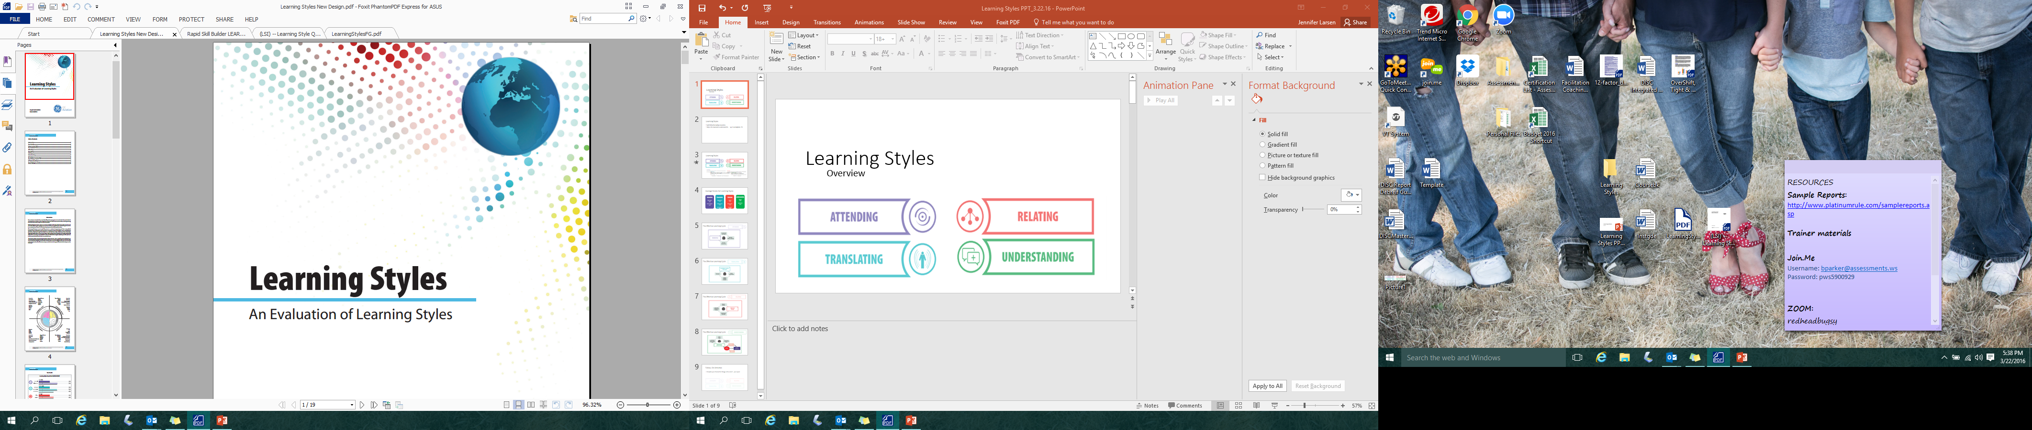
Learning Styles
Notes:
For centuries, scholars and scientists have studied learning, and struggled to understand exactly how people learn. First, there is no single definition of learning styles – it’s believed to be made up of perception, memory, cognition and understanding, and some unique process for gathering information.
Second, all learners are not equal. They come from a variety of cultural backgrounds, have varied experiences, and bring different credentials to the learning environment. They also have unique learning styles and diverse preferences for learning. Some prefer learning from text while others want visual representation and images. Some will assimilate information individually while others prefer to work in groups.
The only thing that can be said with certainty is that each person learns in their own way.
Our hope is that at the end of our time today, you have a more comprehensive knowledge of your own preferences, your own abilities, and your learning style to be the most engaged learner you can be.

Slide 2
DISCUSSION
In pairs, think about a recent experience you had trying to learn something new (a new computer program, procedure, activity, putting something together, etc.)
Tell your partner about your experience
Make a quick list with a plus on one side and a minus on the other. Jot down a couple of positives about how you learned, and some specific negatives. Ex. The instructor engaged with learners (plus) I didn’t have enough time to collaborate with others (minus)
©2016 Assessments 24X7
Notes:
In pairs (perhaps with the person sitting next to you), think about a recent experience you had trying to learn something new – it might be a new computer program, procedure, way of doing something, putting something together (assembly), studying for an exam – anything like this. Tell your partner about your experience. Make a quick list with a plus on one side and a minus on the other. Jot down a couple of positives (pluses) in terms of how you learned, and some specific negatives (minuses). For example, the instructions had pictures that you used to help you (a plus), or the instructions had pictures but they were confusing and hindered your learning (minus). Another might be that the instructor talked too fast (minus) or too slow (minus). Then switch. When we get back together be ready to share the combined list of a few points. You have 10 minutes total for this exercise.
Instructor’s notes:
Call time after 5 minutes and again after 10 minutes. Debrief the exercise by asking for examples of positives and negatives. Draw attention to the differences in how people prefer to learn.
Ask: How many of you have found it easy to learn some material while other times you find it difficult to understand other material? Why do you suppose sometimes it’s easier (or faster) and sometimes it’s more difficult (or slower)? Share group examples to understand differences

Slide 3
Learning Styles
Learning style is an individual's unique approach to learning based on strengths, weaknesses, and preferences.
Learning Styles consists of distinctive behaviors that serve as indicators of how a person learns from and adapts to his/her environment. It also gives clues as to how a person’s mind operates. - Anthony Gregorc
Learning Style is the unique way each individual gathers and processes information. - Nancy Dixon
Are there any additions that should be included in the definition? Any things you disagree with that should be reconsidered?
Learning Style describes a student in terms of those education conditions under which he/she is most likely to learn. Learning style describes how students learn – not what they learn. - David Hunt
Learning Styles are the composition of characteristics and cognitive, affective, and physiological factors that serve as relatively stable indications of how a learner perceives, interacts with, and responds to a learning environment. - Dennis Keefe
Learning Styles refers to the way individual people begin to concentrate, process, internalize and remember new and difficult material. - Rita and Kenneth Dunn
©2016 Assessments 24X7
Notes:
According to the dictionary, Learning style is an individual's unique approach to learning based on strengths, weaknesses, and preferences.
Five leading researchers in the field, have slightly different views which help build a more comprehensive definition of learning styles.
Click to review all definitions one by one.
ASK: Are there any additions that should be included in the definition? Any things you disagree with that should be reconsidered?
No matter what language one uses to define Learning Styles, once we have an understanding of our individual strengths and weaknesses, our biases and preferences, and the learning cycle, we can adjust our individual learning approach to maximize our learning results.
This learning styles overview helps to create a holistic picture of the various ways people learn, and aims to help support your understanding of your own learning style. It is important to remember - All learners possess all styles of the learning model in varying degrees depending on preferences.
We will explore these 4 dimensions of learning in our time today:
Attending – Motivation and Attention to Learning
Translating – Making Information Meaningful
Relating – Linking Data to Existing Knowledge
Understanding – Using and Applying the Knowledge

Slide 4
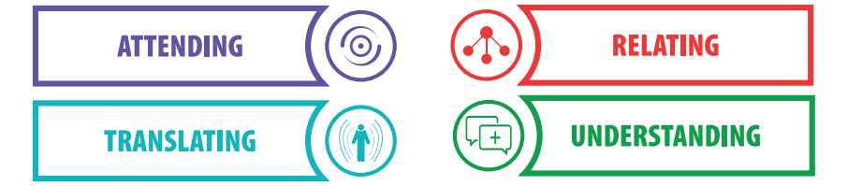
Learning Styles Overview
Attending: Examines motivation to learn and levels of commitment or concentration
“Telescopic” and “Wide-Angled”
Relating: Considers individual’s perception of data or information, and how it is related to existing knowledge
“Visual”, “Auditory”, or “Kinesthetic”
Translating: Looks at whom an individual relies on most in managing transfer of learning, and to make sense of what they see, hear or sense
“Dependent”, “Collaborative”, and “Autonomous”
Understanding: Reviews an individual’s preferences for synthesizing data or information they receive “Global” or “Analytical”
Notes:
The Learning Styles assessment uses four categories to describe the natural cycle we all follow when we try to learn something new or different. This cycle happens in sequential order and includes Attending, Translating, Relating and Understanding.
Click to reveal each definition one by one.
ATTENDING looks at an individuals motivation to learn, and the level of commitment and concentration when new information is presented. There are 2 sub scales – Telescopic and Wide-Angled.
Telescopic means they are generally effective at concentrating without worrying about physical context.
Wide-angled means they are easily affected by environmental factors like noise, light, or other physical influences.
Ask: How does the environment affect Wide-Angled and Telescopic learners? Discussion as a group
TRANSLATING looks at whom an individual relies on most in managing the transfer of learning, to make sense of what they see, hear or sense. It is how information is made meaningful. There are 3 sub scales – Dependent, Collaborative, and Autonomous.
Dependent means the individual will mainly rely on a trainer or facilitator for information.
Collaborative means the individual will mainly favor group discussions or team activities for learning.
Autonomous means that self-reliance is the preferred way to mange the learning transfer process personally.
ASK: How can you reach all three learner preferences in one learning situation?
RELATING looks at an individuals perception of data or information and how it is related or linked to existing knowledge. It has 3 sub scales – Visual, Auditory, and Kinesthetic.
Visual is the preference for information that can be seen with the eyes.
Auditory is the preference for information that is heard.
Kinesthetic is the preference for information that can be experienced through touch, smell or taste.
ASK: What are some ways (clues you might use) to identify the learning preference: Visual, Auditory, Kinesthetic?
UNDERSTANDING looks at the individual’s preference for synthesizing data or information that they receive or how we use and apply information. It has 2 sub scales – Global and Analytical.
Global is the preference for understanding the conceptual or “big-picture”.
Analytical is a preference for understanding at a more detailed level and a step-by-step approach.
ASK: What is the benefit to having a Global preference? What is the benefit to having an analytical preference?
Check for understanding before clicking to next slide - ASK: Any questions, additional thoughts?

Slide 5
Average Scores for Learning Styles
Translating Dependent: Collaborative: Autonomous:
Relating Visual: Kinesthetic: Auditory:
Understanding Global: Analytical:
Attending
Telescopic: Wide-Angled:
55%
45%
52%
22%
26%
45%
25%
30%
53%
47%
Why is it important to know if someone has a different preference than you do?
Notes:
As we already discussed, each of us learns in all four dimensions, and all sub-dimensions, though we may tend to be more telescopic or more wide-angled, more dependent, more collaborative or more autonomous, more visual, more kinesthetic or more auditory, and more global or more analytical as we move through the learning cycle.
Click to show each percentage grouping.
The percentages show the statistic of the percentage of people who tend to prefer each sub-dimension. The relevancy here two-fold: you can see how your preference compares to others in the population, AND you can easily see how many learners are potentially different from you.
ASK: Why is it important to know if someone has a different preference than you do? Potential answers:
They may be engaging in learning differently
They may need a different environment to be as effective as possible to ATTEND
They may need additional support in other ways than I do to TRANSLATE well
I may need to adjust my approach to help them understand something more thoroughly to RELATE
I may need to share more information or less information to help them UNDERSTAND
Now, let’s look at how these 4 come together sequentially in the learning cycle.

Slide 6
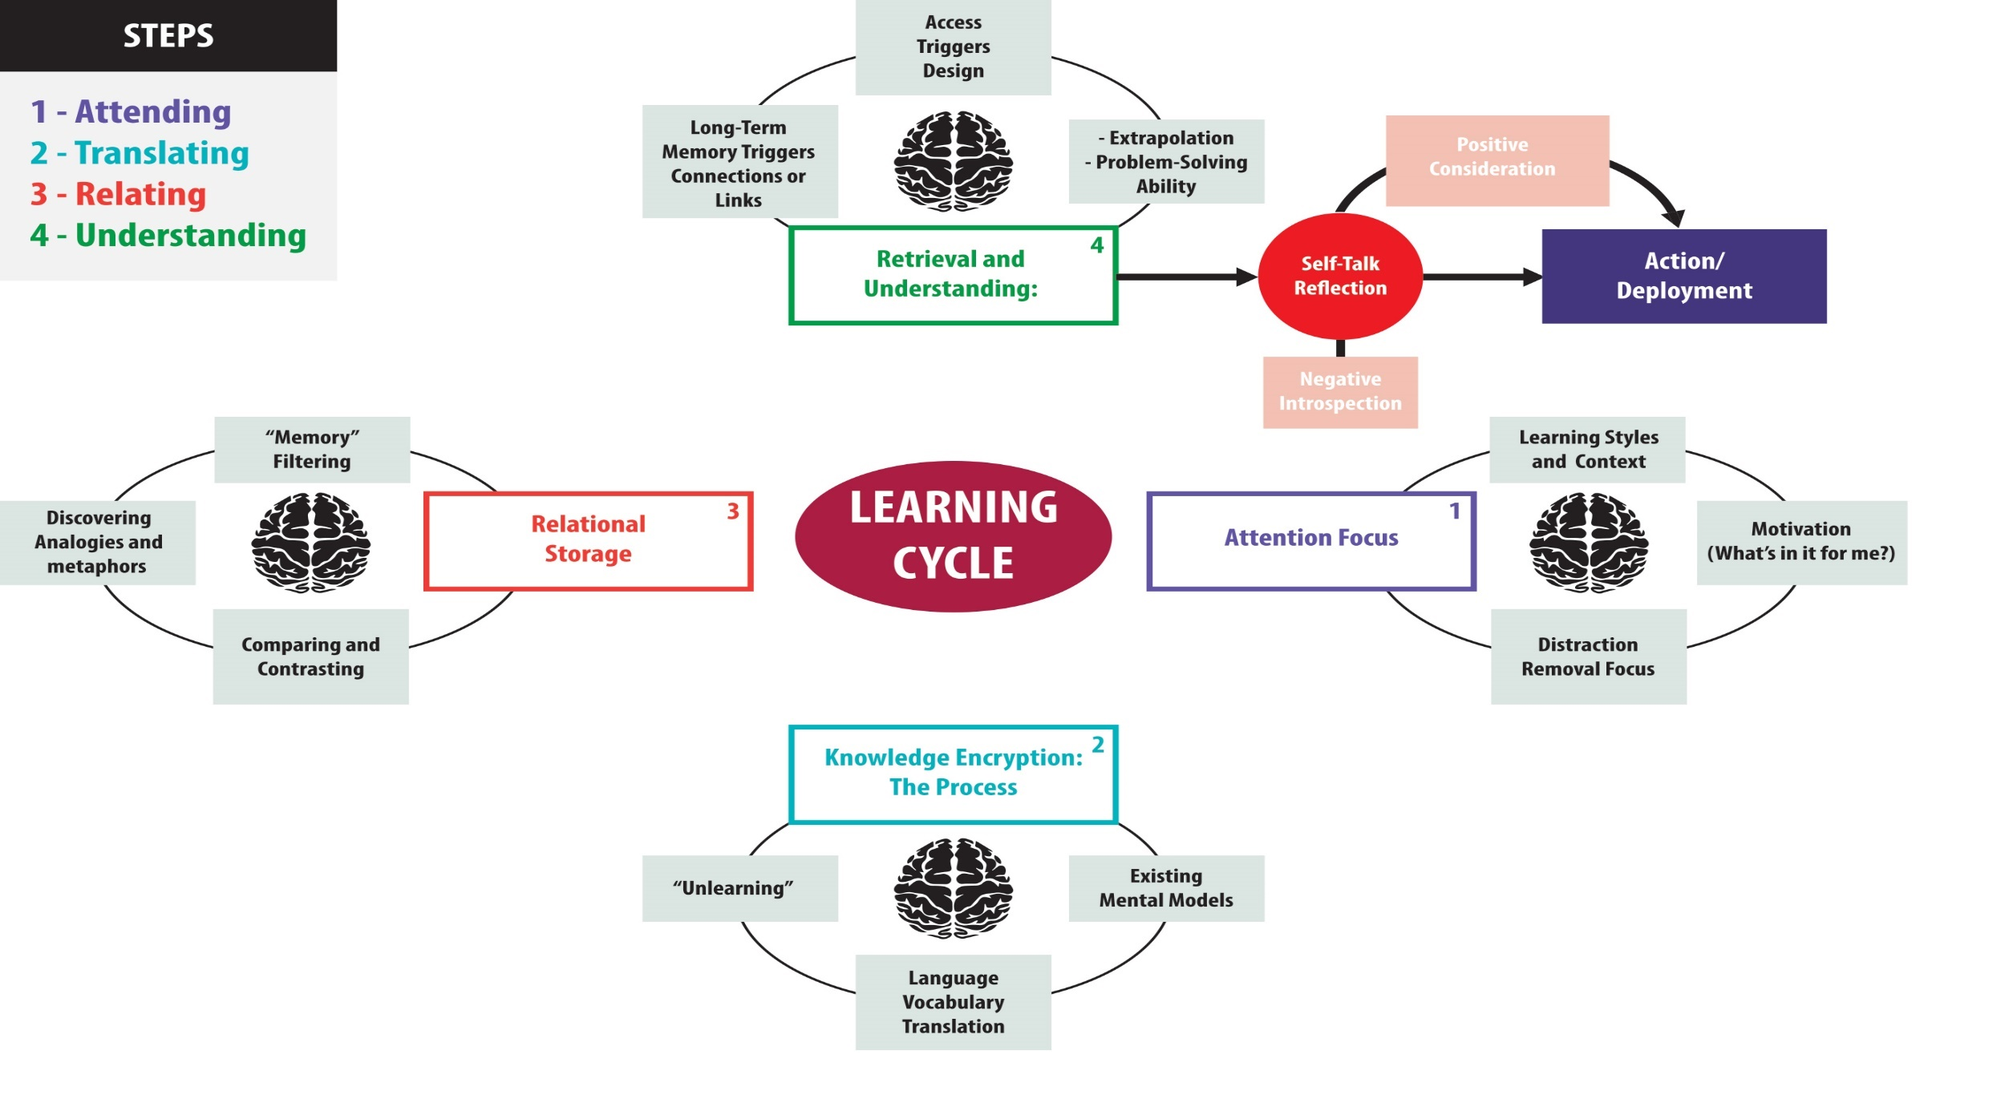
The Effective Learning Cycle
Notes:
Overview of the Effective Learning Cycle
Even though we all bring our own history, preferences, skills, and more to each new situation, we all go through the same process to evaluate information before we do something with it. The process can be completed in our brain in seconds, but may take longer if something is confusing or complex.

Slide 7
The Effective Learning Cycle
Notes:
Overview of the Effective Learning Cycle
The next several slides will pull together the 4 steps we all use to process what we learn.
This same information is also in your Learning Styles report so you will have the visual models of each slide to take with you.

Slide 8
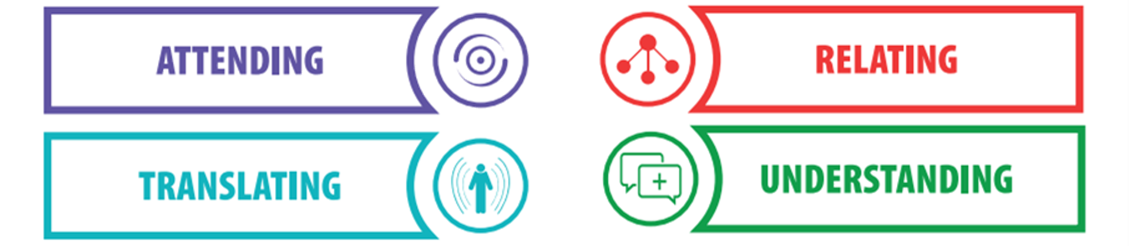
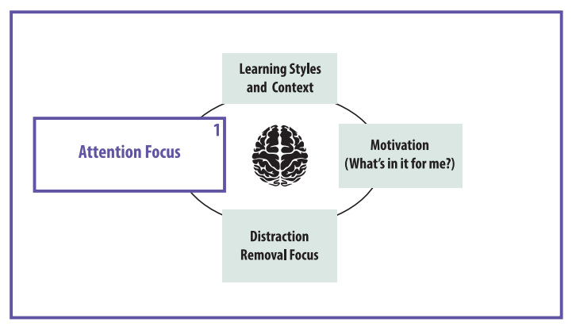
The Effective Learning Cycle
Telescopic
Wide-Angled
Notes:
Step 1: Attending – Attention Focus
Attending is paying attention – filtering out the inhibitors (distraction removal) and give the learning our full attention (learning style and context). It encourages our motivation to learn.
Ask: Do some people seem Pay Attention better than others? How do you know? Why does this happen? Discussion as a group
Attending allows us to recognize the message, the context (what’s going on around us at the time we are learning), and our commitment to learning.
This primarily right-brained activity examines the context within which the information we will receive will be valued and evaluated (what’s in it for me?).
Remember: Attending is measured in two sub-scales: Telescopic and Wide-Angled. NOTE: This is generally not changeable – you are hard wired to be either telescopic or wide-angled.
Telescopic: focus on the core message without distraction by ambient interference
Wide-Angled: notice the whole learning environment and can let side issues or distractions interfere with the core message
Ask: If you know that you are telescopic, or someone you are working with is, how could this help when learning something new. Discussion as a group
ASK: What are some things for you that make it hard to give your full attention to learning? What can you do about them? Individual reflection

Slide 9
Motivation
Think of something you know you really SHOULD pursue learning about
Consider:
your interest level
your ability to persist with the learning
your support needs
Talk through these three with respect to your learning goal with your partner
Are you motivated to learn?
Notes:
Motivation is an essential pre-condition to learning. No one learns anything by being disinterested or passive. The learner has to be motivated to learn.
Ask: How can we tell if others are motivated?
How can we help others to be motivated? Group Discussion Typical responses: ask them what they hope to learn, what is exciting about the topic for them, what they think they will get out of it, etc. Stir the curiosity of the learner somehow, perhaps by helping see how they can benefit from the learning.
Activity:
Think of something you know you REALLY SHOULD pursue learning about. For example, learning a new computer program, learning how to manage your time better through a time management course, learning about a medical treatment that you or a family member might need in the future, researching colleges or schools for your children, etc. Then consider : your interest, ability to persist with the learning, and your support needs. Talk through these three with respect to your learning goal with your partner. You can help each other with this process.
NOTE: Motivation needs to be upheld in all three, not just one. If you are not interested, if you have no ability to persist with the learning, or if your support needs aren’t met, motivation and learning will be a challenge.

Slide 10
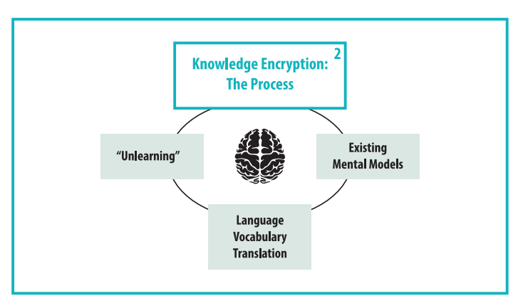
The Effective Learning Cycle
Dependent
Collaborative
Autonomous
Notes:
Step 2: Translate - Knowledge Encryption
Translating incudes Language, Style, and delivery. We all use all three translation modes, but we all have a primary preference. As we work through these, determine which translation method most closely matches your preference: Dependent, Collaborative, and Autonomous.
Dependent: expect leaders to help them manage translating what they see, hear or sense
Collaborative: talk about issues raised in groups to help them translate what they see, hear or sense
Autonomous: challenge assumptions and reflect upon information by themselves
We translate the information in a way that makes sense with our existing knowledge (Existing Mental Models & Language Vocabulary Translation) or ideas of the way things should work. We may have to “unlearn” something (unlearning) before we can encrypt or encode our new learning to be meaningful. This is primarily a left-brained activity connected with logic and reason.
For example: If every dog we meet from ages 1-5 is large and growls, we conclude that all dogs are large and growl. At age 6, we meet a small dog who doesn’t growl, and our brain must examine what that means about dogs. Perhaps they all aren’t large and don’t all growl! We may have to unlearn our earlier knowledge before being able to believe there may be more dogs that are not big and do not growl.
Think about the way you may have learned some information and then how you learned something new that caused that to change. Did you need more evidence to believe the new information? Did you feel skeptical at first? Did you accept the new information without any hesitation?
There are many things that can influence the way we translate our world to make things meaningful. Sometimes it can be our families, friends or community. Sometimes it is a co-worker or boss. Sometimes we learn new things on our own and must make sense of them individually.
ASK: What are some influences that help you translate information to make it meaningful?

Slide 11
Translating
Use the learning situation you discussed earlier with your partner and consider which of the three translating modes would work the best for you in trying to master this new material.
Is this your primary style?
If so, what can you incorporate from some of the other modes to enhance the learning experience for you?
If not, what will be challenging for you?
Also, consider those that are not your preference, but are likely to come up for you in your learning. What can you do to manage these, given they are not your preference?
Review with your partner the likes and dislikes and circle those that might work for you in your situation.
Notes:
Activity:
Pairs discussion, particularly the benefits of unusual ways of learning outside of comfort zone
Use the learning situation you discussed earlier with your partner and consider which of the three translating modes would work the best for you in trying to master this new material.
Is this your primary style?
If so, what can you incorporate from some of the other modes to enhance the learning experience for you?
If not, what will be challenging for you?
Also, consider those that are not your preference, but are likely to come up for you in your learning. What can you do to manage these, given they are not your preference?
Review with your partner the likes and dislikes and circle those that might work for you in your situation.

Slide 12
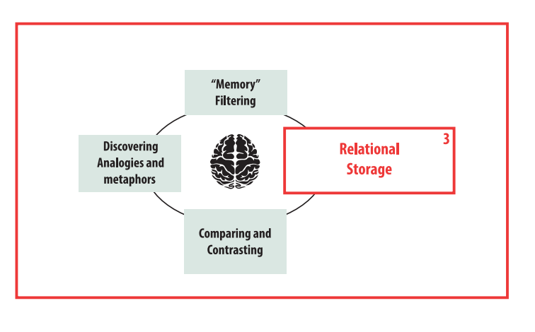
The Effective Learning Cycle
Visual
Auditory
Kinesthetic
Notes:
Step 3 – Relating - Relational Storage
This step has to do with relating the new learning with what we already know. We must relate the information to existing patterns or knowledge in our short-term or long-term memory in order to connect the new information with old information and store it in the most relevant place. Through memory filtering, discovering analogies and metaphors, and comparing and contrasting, we find the right place the new information “belongs”.
This is predominately a right-brain activity - to connect with associated general ideas and relationships.
This area relates to brain research - the left side of the brain handles logic, language, math, and analysis and the right side is creative handling visual, imagination, recognition, rhythm, and music. We all use both sides of our brain, though in different ways and each side contributes much to our ability to learn.
There are three primary learning categories: Visual (seeing, writing), Auditory (hearing, reading) and Kinesthetic (doing, creating).
There are countless ways we can sort and store information. Think of your brain as a filing cabinet. We store information by categories, and file it away in the most applicable places that make the most sense to us. We also may have different folders in our filing cabinets than others do, so our neighbor’s brain may not store information in the same way or same place as ours does.

Slide 13
VAK Activity
Using the VAK chart, place:
a checkmark next to those that work best for you
a star next to those you would like to try to expand your range
Discuss pros and cons of each as you work through the list. Then add up your numbers for each column to determine your preferred learning method.
Notes:
These categories have to do with HOW you gather or deliver material so that it appeals to both sides of the brain, thus maximising the likelihood of retention.
Using a variety of training methods makes learning more interesting. We use visual channels through use of the video, slides, booklets and templates. We use kinaesthetic methods by exercises using the concepts and material we are discussing, taking notes, and later, using the template to record your actions using the material. We use auditory learning by talking, video characters interacting with each other and a narrator explaining the topic area. The hope is that the material will “stick” better for learners by learning about it using different modalities.
Activity:
Using the VAK chart, make a checkmark next to those that work best for you and a star next to those you would like to try to expand your range. You are welcome to do this with your partner and discuss pros and cons as you work through the list.

Slide 14
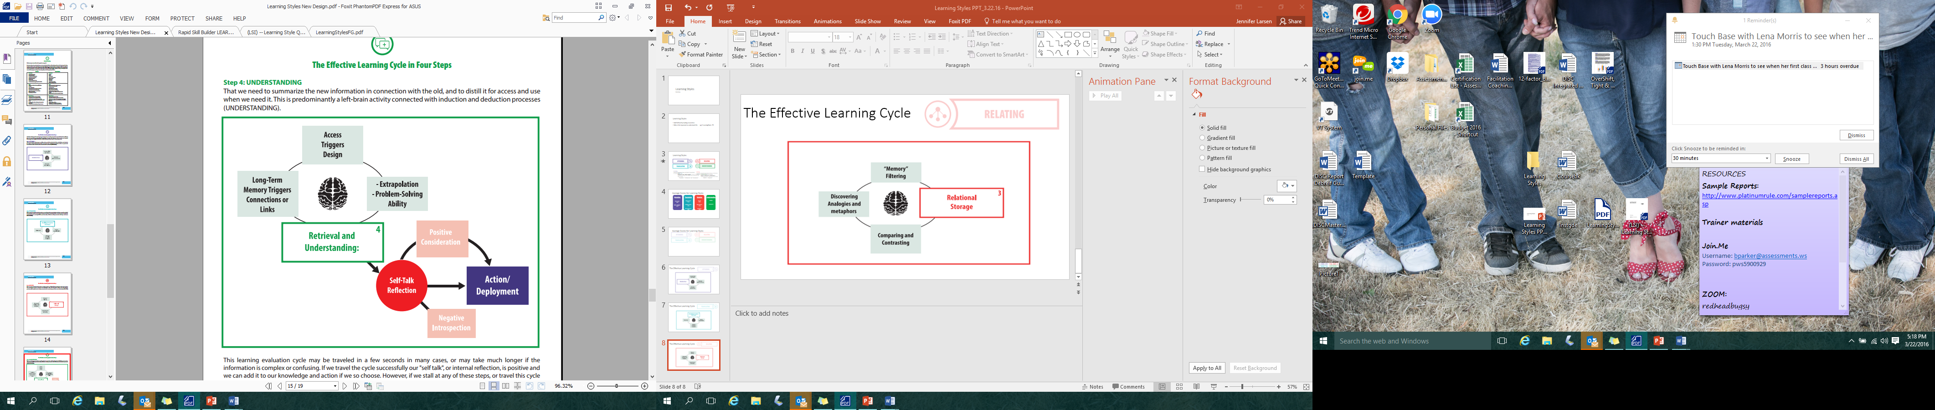
The Effective Learning Cycle
Global
Analytical
Notes:
Step 4: Retrieval and Understanding
In the last step we summarize the new information in connection with the old and refine it for access and use when needed. This is predominantly a left-brain activity that connects induction and deduction processing. Long-term memory triggers connections or links, access triggers design and extrapolation, and problem solving abilities are influenced by retrieval and understanding (we use what we can find, so to speak). Understanding is all about taking core information, and knowing when and how to apply it to wider situations.
How we look for ways to apply learning is Understanding. There are two ways we can do this: Global and Analytical.
Global:
Seeing the big picture
Reading between the lines
Seeing options
Analytical:
Details, focus
Consistency
Objectivity

Slide 15
The Effective Learning Cycle
Notes:
Step 4: Retrieval and Understanding/Self-Talk, Reflection
In the learning cycle, we constantly evaluate what we are experiencing within the context of our past history and everything we already know. In this stage we are making a judgment about what we have heard, seen and experienced and deciding if it is valuable, or not. If not, we will most likely not commit the learning to long-term memory and it will be lost.
As the slide indicates, this reflection step can be:
positive – we think the learning is valuable and might be worth acting upon
negative – we don’t think it has enough value, or we don’t understand it, or think it is too much work to do something about
cause to re-think the learning: This can stall us, or we may try again to see if we can work out the problem more effectively. Re-thinking can involve considering the information, turning it over in your mind and can have positive outcomes if you end up building on it and turning it into valuable learning that can be retained.
ASK: How can our internal reflections/self-talk inhibit or support taking action?

Slide 16

The Effective Learning Cycle
Action & Deployment
Notes:
The “Action” is straightforward – applying the new learning yourself in some tangible way. We have all had experiences when we failed to apply something we learned. For example, consider a foreign language you may have taken as a course in school and then didn’t keep up … chance are you haven’t retained much at all from what you learned and studied if you haven’t used that knowledge. Perhaps you have taken a computer course that was valuable but you didn’t apply what you learned in time to make it “stick.” You must act upon learning to make it move into long-term memory.
apply the learning yourself to make it “stick.”
extrapolate – draw from the learning or even create new learning from it. Look for opportunities to generalize, or make intelligent inferences based on what you have learned.
build on the new learning by adding depth and complexity to your new knowledge. Study “around” the learning topic.

Slide 17
Action & Deployment
Return to the situation you worked on earlier - something you really should learn. Examine 3 specific ways to keep the learning alive in your long-term memory. Discuss with your partner and share feedback.
*You can use Apply, Extrapolate and Build to help guide you:
apply the learning yourself to make it “stick.”
extrapolate – draw from the learning or even create new learning from it. Look for opportunities to generalize, or make intelligent inferences based on what you have learned.
build on the new learning by adding depth and complexity to your new knowledge. Study “around” the learning topic.
Notes:
Activity: In pairs - return to the situation you worked on earlier when you thought of something you really should learn more and examine how will you apply and build upon the new learning to keep it alive in your long-term memory. Consider 3 ways to do this and discuss with your partner. You can use the idea of Apply, Extrapolate and Build to help guide you.

Slide 18
Effective Learning
Effective Learning:
A facilitator or trainer can identify individual learning styles and vary delivery to optimize transfer of learning
OR
An individual learner can recognize their own preferences in learning and make adjustments themselves to be successful
Either way, engagement with the knowledge is essential for success.
Notes:
Two ways to reach effective learning include facilitator-influenced or individual-driven. A facilitator or trainer can identify individual learning styles and vary delivery to optimize transfer of learning OR an individual learner can recognize their own preferences in learning and make adjustments themselves to be successful. Either way, engagement with the knowledge is paramount for successful learning.
Both approaches together, though, coupled with a variety of learning options that cover may preferences, is the best way to ensure learners will have positive and meaningful learning experiences.
Note: it is important to recognize that both types of learning styles are likely to be represented in a population, so you may need to take care to appeal to both when you are teaching others. Usually, people use the style they themselves are most comfortable with (if they are an analytical, they will likely use analytical methods and style) even if they are dealing with someone who has a very different style.

Slide 19
Application of Learning
Activity
You are teaching or coaching someone on a common work process in your area. The person has a learning style that is not your own (if you tend to be more Analytical, that person is Global and vice versa).
Choose 3 actions to teach them effectively.
Discuss with your partner & share feedback and ideas.
Notes:
15 minute pairs: 5 min brainstorm, 5 min each person share -
You are teaching or coaching someone on a common work process in your area. The person has a learning style that is not your own (if you tend to be more Analytical, that person is Global and vice versa).
First, think about how you would prepare and conduct the coaching and training with them to take into account their learning style. Choose 3 actions you would take. Describe to your partner the situation and the approach you would take. Get ideas from each other and discuss.

Slide 20
Learning Styles Report Debrief
Notes:
Refer to Debrief Guide

Slide 21
Application of Learning
Engage in learning opportunities:
Participate in the learning event, reflect on what you learned, predict “the way things should work” based on what you learned, and try it out to see what does work.
Complete your Contract for Change at the end of your report
Start/Stop/Continue
What is one thing you can start doing to leverage our learning style preferences to be a more effective learner and educator?
What is one thing you can stop doing to be a more effective learner and educator?
What is one thing you can continue doing that works well for engaging in learning?
Notes:
What can we do to continue to strengthen and build this muscle in the coming days, weeks, months?
Engage in learning opportunities
Complete your Contract for Change, and follow through on it
Start/Stop/Continue

Slide 22
Closing Thoughts
Remember:
Each person learns in his/her own way
Learning is ongoing and dynamic
Using a variety of methods, activities, and styles will help to accommodate the different learning styles and preferences
Notes:
Learning is something that occurs constantly. It’s a process of involvement with the world around us. Most of us need to relate our learning to our experiences to create context and meaning and find ways to apply what we have learned.
You now have a more inclusive awareness of your own preferences, your own abilities, and your learning style to be the most engaged learner you can be. You can also helps others to be their best by using that same awareness to help them engage in and understand the process and improve their own learning.
Though you may not be an “educator” by profession, you do have opportunities every day to “teach” and influence people. Those opportunities can be maximized by your attention to others’ learning styles. The more you know how someone learns best, the more you can work to adjust your delivery and style so that they master and retain what you teach them.

Slide 23
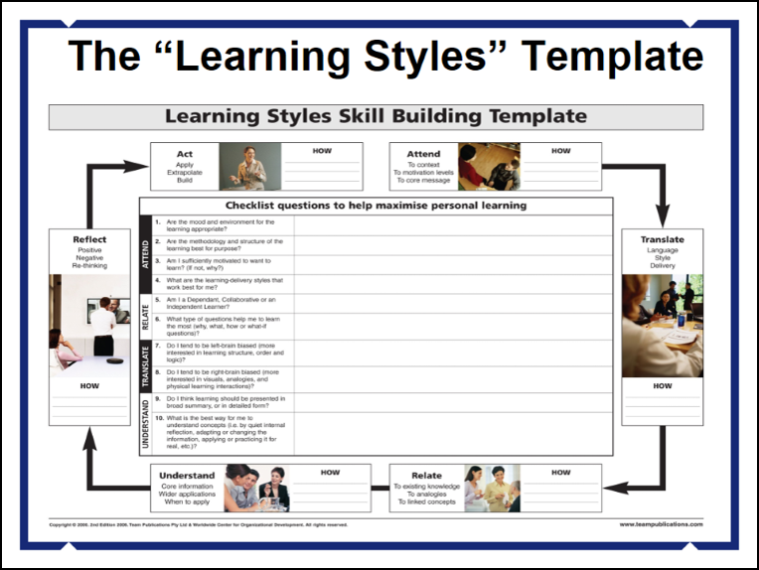
Putting it Together
Optional Exercise: Using the Learning Styles Skill Building Template handout, complete in pairs.
Answer “Checklist Questions”
Complete Learning Cycle brainstorming boxes to outline “how” for each area
Notes:
This slide is an optional activity that can be included At the close of the “Classroom Training” Portion, prior to the Learning Styles Report Debrief.
If done in class:
Using the Learning Styles Skill Building Template handout, complete in pairs.
Answer “Checklist Questions”
Complete Learning Cycle brainstorming boxes to outline “how” for each area
Alternatively, the template can be sent home with the learner to complete as a follow up exercise.

